Slide 1



SAP IBP IMPLEMENTATION
(Mexico)
ISOM 825 FINAL PRESENTATION
Team 4 - Dharmin Sanghvi, Keerthana Tamtam, Prajakta Khare & Punya Kaura

Slide 2





Meet
THE TEAM
Punya Kaura
Prajakta Khare
Dharmin Sanghvi
Keerthana Tamtam

Slide 3

Table of
CONTENTS
01
02
03
04
Introduction
Company Background
Interviewee’s Background
Reasons for ERP System Adoption
05
06
07
08
Data Management before & after ERP Adoption
Ongoing Data Management Challenges
Interviewee Perspective
Future Plans

Slide 4

INTRODUCTION
Enterprise Resource Planning (ERP) system adoption offers companies streamlined processes, centralized data management, enhanced reporting and analytics, improved communication, standardized operations, scalability, cost saving etc ultimately empowering them to operate more efficiently, make informed decisions, and mitigate risks.
Centralized data management facilitates easier access for decision-making, while standardized processes ensure consistency and compliance. Real-time access to information enhances communication and collaboration among teams. Scalable solutions accommodate growth, leading to long-term cost savings and improved profitability.

Slide 5

Walmart’s Background
Walmart is the world's largest retailer, operating over 10,500 stores under 46 banners in 24 countries and eCommerce websites, serving nearly 230 million customers weekly.
Offers a wide array of merchandise, including groceries, apparel, electronics, and home goods, focusing on affordability and convenience for diverse consumer needs.
Pioneering in supply chain management and sustainability, Walmart invests in renewable energy and eco-friendly practices while advancing in technology for improved shopping experiences.

Slide 6

Interviewee’s Background
Name : Sergio Esquivel
Designation : IBP Senior Manager, Walmart Mexico
Job Role :
Overseeing the development of the Integrated Business Planning (IBP) model for self-service formats within the IBP Center of Excellence (CoE) at Walmart.
Coordinating the strategic alignment of omnichannel sales projections, covering a significant portion of national sales with numerous stakeholders.
Leading the project management for the implementation of SAP IBP software, focusing on demand and sales & operations planning modules.
Facilitating collaboration across functional, technical, and consulting teams, integrating various efforts and priorities using the SAP Activate and Agile Data Analytics methodologies.

Slide 7




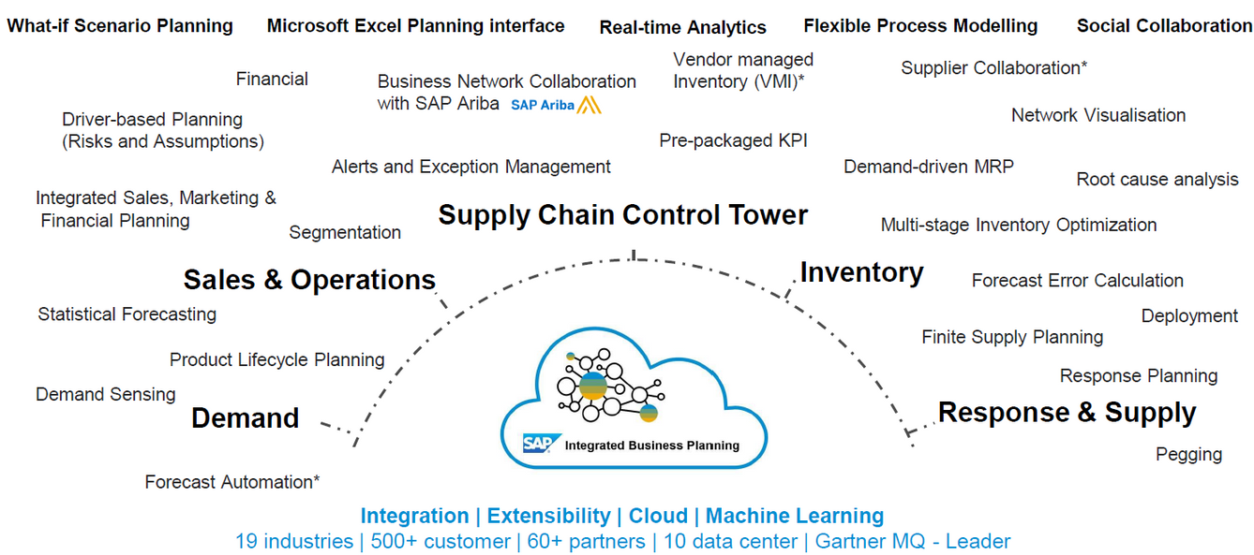
WHY SAP IBP?
User-Friendly Interface
SAP IBP for demand is designed with ease of use in mind, featuring a user-friendly interface that simplifies complex planning processes.
Renowned Expertise
Leveraging SAP's global reputation for business and technology excellence, it delivers tailored engagement services for customized planning solutions
Streamlined Business Processes
SAP IBP for demand centralizes and simplifies business planning, fostering collaboration while reducing system failure risks and the need for offline data handling.
Seamless Integration
Offers smooth integration capabilities, enabling a unified platform that consolidates data and processes for enhanced visibility and control.

Slide 8
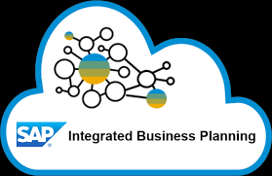

REASONS FOR SAP IBP SYSTEM ADOPTION
Transition to Long-Term Strategic Planning:
Necessity to shift from a short-term, reactive approach to a long-term, strategic management perspective to sustain market and financial goals.
Overcoming Spreadsheet Limitations:
Existing reliance on offline spreadsheets and disparate data sources became untenable due to inefficiencies and limitations in handling complex data.
Handling Rapid Business Growth:
The rapid expansion of business operations presented significant challenges in scaling up the planning processes effectively.
Resource Intensive Processes:
The manual and frequent ad hoc data conversions required by the previous system consumed excessive resources and were too time-consuming.
Increasing Complexity with Stakeholders and Suppliers:
As the number of internal stakeholders and suppliers grew, the complexity of data management and coordination also increased, necessitating a more robust system.
Need for an Integrated Planning Framework:
A unified and integrated planning solution was needed to streamline operations, enhance accuracy, and reduce the overhead associated with maintaining multiple systems.

Slide 9
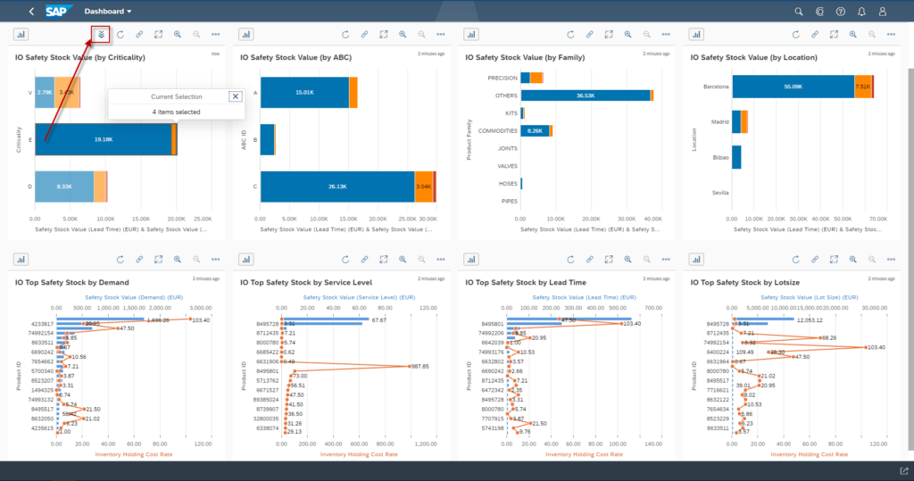
OBJECTIVE OF PROJECT
Implementing SAP IBP for demand enables a holistic planning process that drives business growth across all levels, leveraging technology for strategic and tactical alignment.
The solution facilitates real-time collaboration with internal and external stakeholders, ensuring that practical tactical plans are developed and aligned with business strategies seamlessly.
By consolidating diverse product categories across various locations, SAP IBP establishes new hierarchies, enhancing efficiency and clarity in category management across the organization.
Supporting flexible planning horizons ranging from short-term to long-term, SAP IBP empowers detailed analysis and insights, facilitating informed decision-making processes for sustainable business success.

Slide 10

SAP IBP LAUNCH- A MILESTONE ACHIEVED
ANALYTICS AND FORECASTING
STRATEGIC INTEGRATION
ONGOING IMPROVEMENT
EXTENDED CAPABILITIES
Advanced data analytics incorporated into SAP IBP empower Walmart with predictive insights, preparing the company for proactive demand planning
SAP Preferred Success plays an integral role, ensuring the SAP IBP for demand is customized to meet Walmart's unique retail needs.
Commitment to continuous development with SAP's expert guidance, focusing on user experience, system optimization, and expanding functionalities.
Leveraging SAP Business Technology Platform (BTP) solutions, including Application Development, Extended Planning, Data and Analytics, Integration, and Artificial Intelligence for a comprehensive planning ecosystem.

Slide 11
SAP IBP LAUNCH- A MILESTONE ACHIEVED
DATA HANDLING
END-USER ENGAGEMENT
GO-LIVE SUCCESS
Marking a strategic milestone, after one year SAP IBP went live on March 23, 2023, positioning Walmart de México y Centroamérica at the forefront of retail planning technology.
Integration of 35 SAP Cloud data inputs and manual processes, managing over 2 million product intersections weekly.
Immediate adoption by 373 end users, signifying robust training and a seamless transition to the new system.

Slide 12

BUSINESS AREAS IMPACTED BY THE ADOPTION OF SAP INTEGRATED BUSINESS PLANNING (SAP IBP)
Category Strategy and Financial Planning: There was a notable 42% reduction in the hours dedicated to IBP processes for category strategy managers and financial planning. This was achieved through real-time collaboration, permission filters that reduce human errors, enhanced data consistency, and comprehensive traceability​​.
Forecasting Accuracy: The adoption of SAP IBP resulted in a 3.6% reduction in the weighted mean absolute percentage error (wMAPE) in forecasting, which helped improve accuracy in category planning. This was supported by deviation alerts for targeted adjustments and analysis in the product-customer matrix​​.
Omnichannel Integration: About 90% of retail volume was integrated into a unified process and system, which marked the first business planning system implementation by the company to smoothly incorporate e-commerce into an omnichannel visibility framework​​.
Operational Efficiency: The implementation streamlined workflows for Walmart’s center of excellence (CoE) team for IBP by replacing multiple isolated Microsoft Excel spreadsheets with a single source running on SAP IBP for demand, which reduced processing time and enhanced operational efficiency​​.
Data Integration and Monitoring: There was a focus on mitigating data discrepancies and advancing overall data integration initiatives through rigorous monitoring, including alert applications, which increased proactive awareness of key figure data readiness and prevented potential discrepancies​​.

Slide 13

ERP IMPLEMENTATION
BEFORE
AFTER
Manual Data Systems
Extensive use of spreadsheets, no integration.
Limited Collaboration
Minimal interaction with stakeholders and suppliers.
Intuitive Decisions
Reliance on gut feeling, not data.
Data Confidence Issues
Questions about data currency and accuracy
Unified Data Platform
Sales data consolidated into one system with SAP IBP.
Immediate Insights
Real-time data informs category sales forecasting.
Collaborative Planning
Teams leverage data for strategic collaboration.
Informed Decision-Making
Data guides risk management and opportunity maximization.

Slide 14
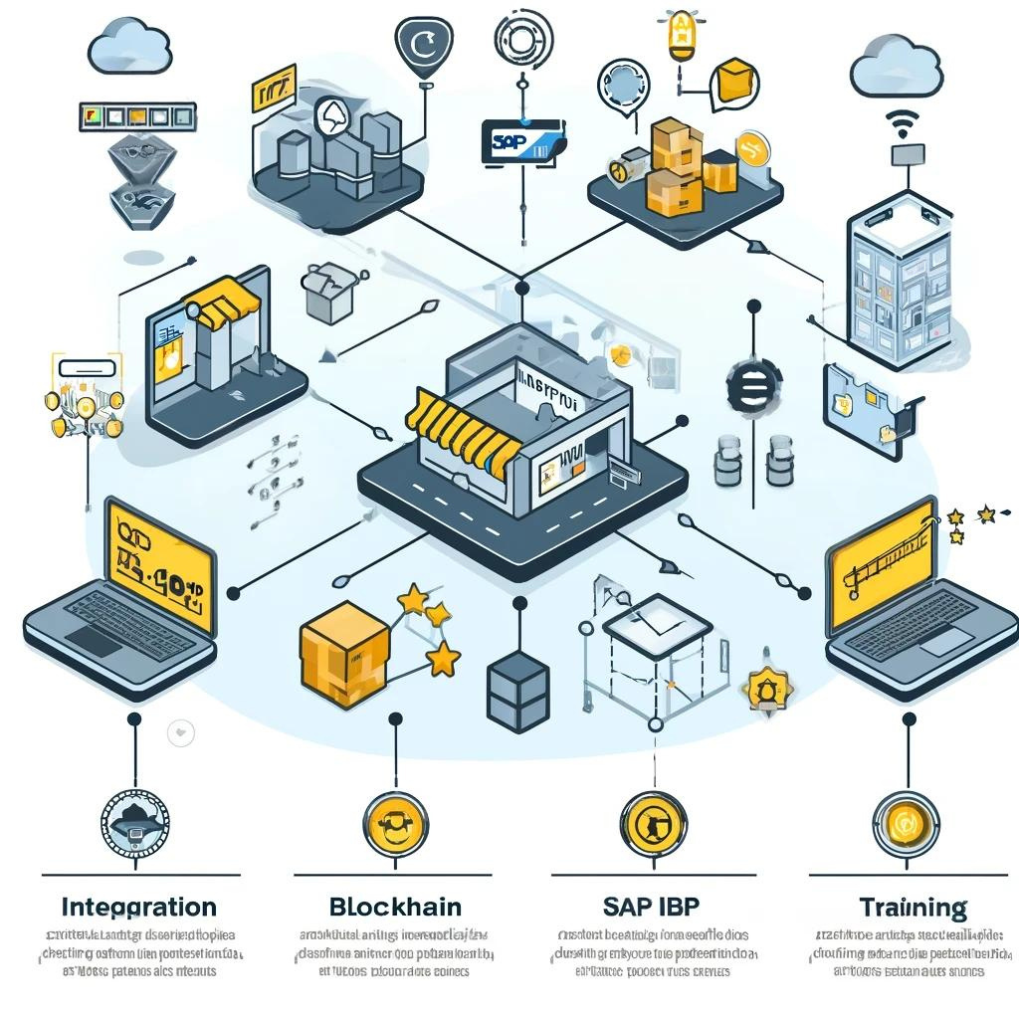
Ongoing Data Management Challenges
Expanding IoT integration to enhance real-time inventory and asset tracking across Walmart’s extensive network of stores and distribution centers in Central America and Mexico.
Implementing blockchain to secure and transparently track cross-border transactions and supply chain activities, enhancing trust and compliance.
Fostering better data synchronization across e-commerce platforms, brick-and-mortar stores, and mobile interfaces to maintain a consistent and seamless customer experience.
Developing targeted training programs for Walmart Mexico employees to increase proficiency with the advanced features of SAP IBP, addressing cultural nuances and resistance to change.
Leveraging machine learning within SAP IBP to refine demand forecasting models, improving accuracy despite fluctuating market conditions and consumer behaviors specific to the Latin American market.

Slide 15
Interviewee’s Perspective
A notable reduction in hours dedicated to nonvalue added tasks, allowing more time for critical issue identification and informed business decision making within the tactical horizon.
Thoughtful role assignment and user permissions boost operational efficiency by preventing unwarranted adjustments between different building blocks and clarifying user responsibility for specific tasks.
Full traceability of collaboration details facilitated more focused discussions with team leaders for useful demand plans.
Process standardization fosters a consistent and efficient planning approach across teams, promoting best practices throughout the company.
Effective summary of team situation, risks, and long term planning opportunities significantly improves visibility and aids decision prioritization during leadership transitions.

Slide 16
Future plans for SAP IBP at Walmart Mexico
Implementing advanced demand planning and sales and operations planning (S&OP) functionalities.
Development of a supply chain Control Tower to enhance visibility and control over logistics and distribution.
Extending SAP IBP integration beyond current categories to include other business segments, enhancing overall planning coherence and efficiency.
Developing tailored analytics and dashboard tools aligned with specific business user cases, designed to address deviations and adapt to shifting market trends.
Replacing in-house R-based forecasting models with more sophisticated multi-regression analysis tools within SAP IBP, aimed at refining accuracy in line with strategic business decisions and external market factors.
Initiating a new vendor collaboration process to improve communication and coordination between Walmart and its suppliers, ensuring a more integrated supply chain.

Slide 17

Thankyou!
Any Questions?

